Slide 1

Performance of the United States COVID-19 forecasting models
Linda Nguyen
CSC400
Professor: Antonios, Imad N.

Slide 2
Motivation
COVID-19 Pandemic has been spreading worldwide.
COVID-19 is a new disease.
Limited understanding of disease progression and of the risk factors for the disease.
Urgent threat to global health.
Become challenge for hospitals and clinics in distributing resource and patients

Slide 3
Goal
Analyze how well the predictive models compare to the reality.
Measure the error between the prediction and the real.
Evaluating models for usefulness / accuracy.
Help government agencies to predict ahead of their emergence, potential future scenarios. Help hospital and agencies for planning and policy making.

Slide 4
Data sources and preprocessing
Predicted data
The Institute for Health Metrics and Evaluation (IHME) https://www.healthdata.org/covid
Ensemble (https://www.cdc.gov/)
Actual data
The Institute for Health Metrics and Evaluation (IHME) https://www.healthdata.org/covid

Slide 5
Predicted data

Slide 6
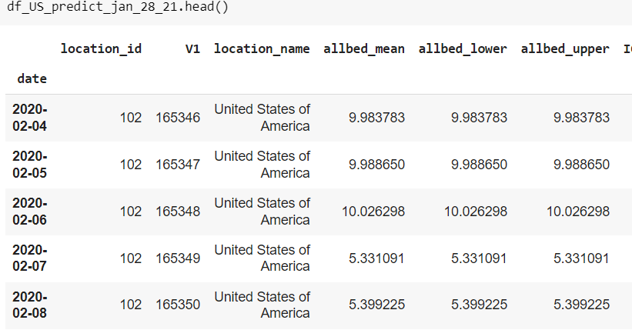
Predicted data
The Institute for Health Metrics and Evaluation (IHME)
There are 4 sets of daily predicted data:
January 28, 2021
April 30, 2021
July 30, 2021
November 1, 2021

Slide 7
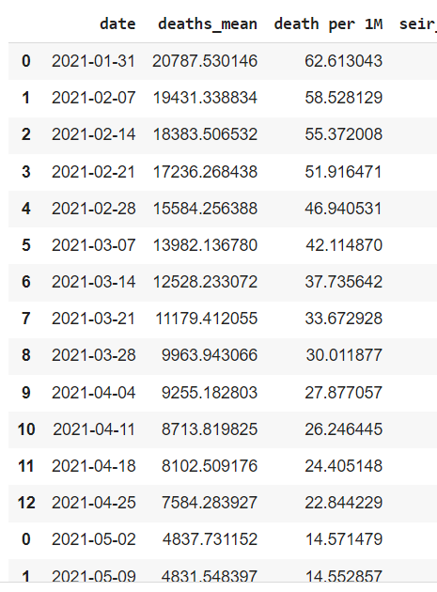
Predicted data
The Institute for Health Metrics and Evaluation (IHME)
Normalize data per million people

Slide 8
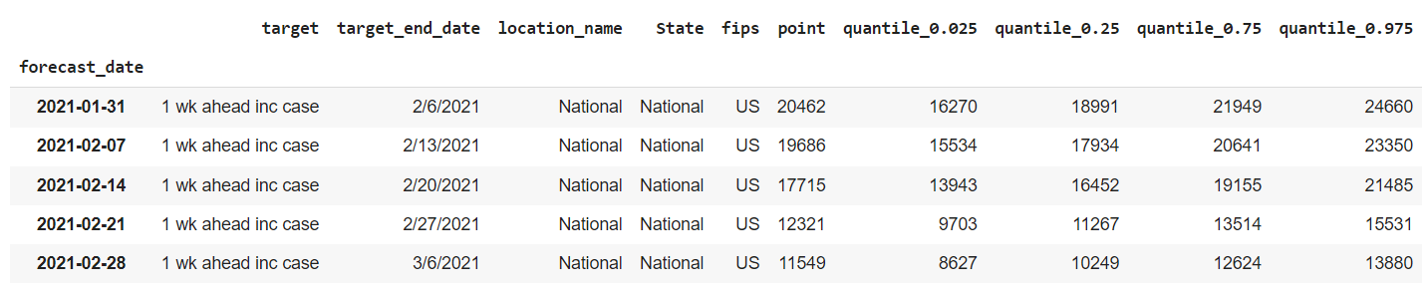
Predicted data
Ensemble (CDC.gov)
Before processing

Slide 9
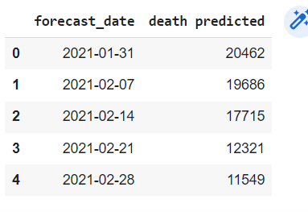
Predicted data
Ensemble (CDC.gov)
After processing

Slide 10
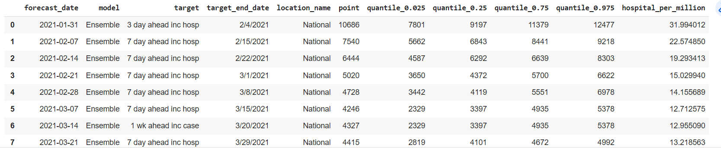
Predicted data
Ensemble (CDC.gov)
Hospitalization

Slide 11
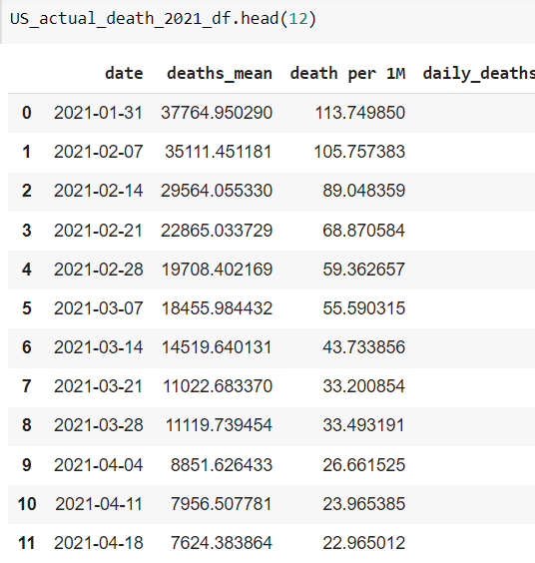
Actual data
The Institute for Health Metrics and Evaluation (IHME)
There are 4 sets of daily actual data:
May 6 2021
July 31, 2021
October 24, 2021
December 12, 2021

Slide 12

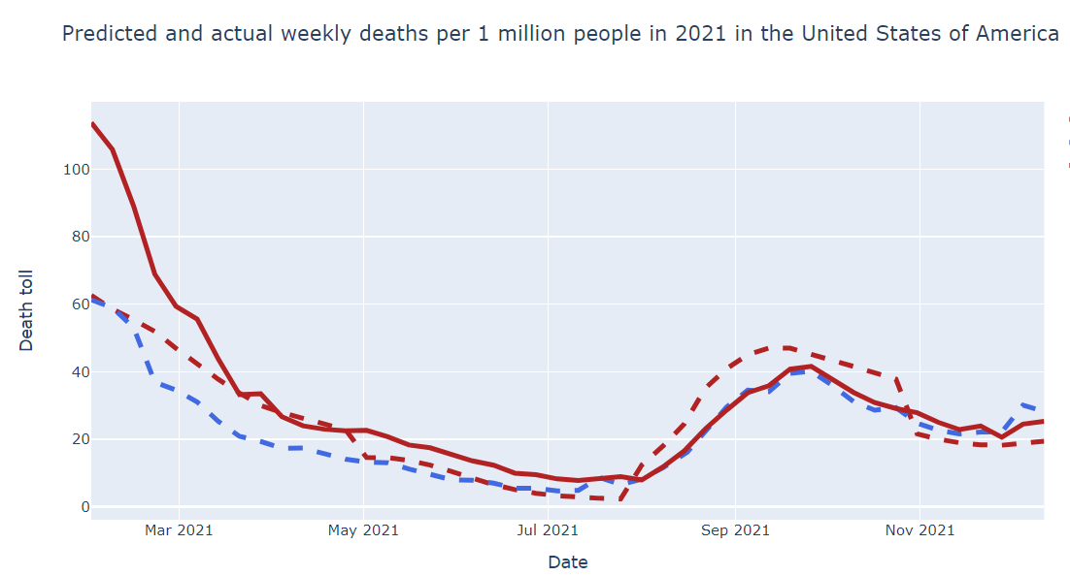
Predicted vs actual deaths

Slide 13
Explain RMSE
Mortality RMSE

Slide 14
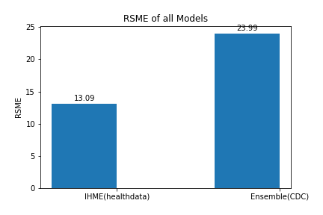
Result
Mortality RMSE

Slide 15

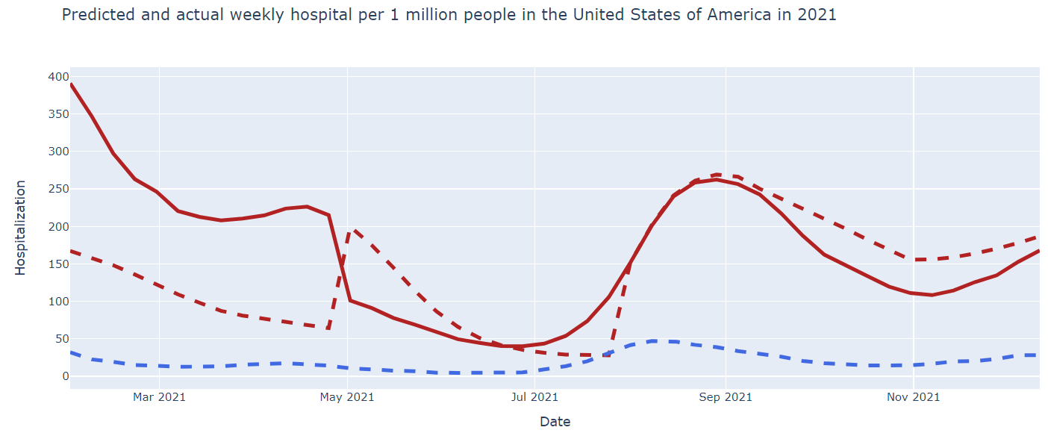
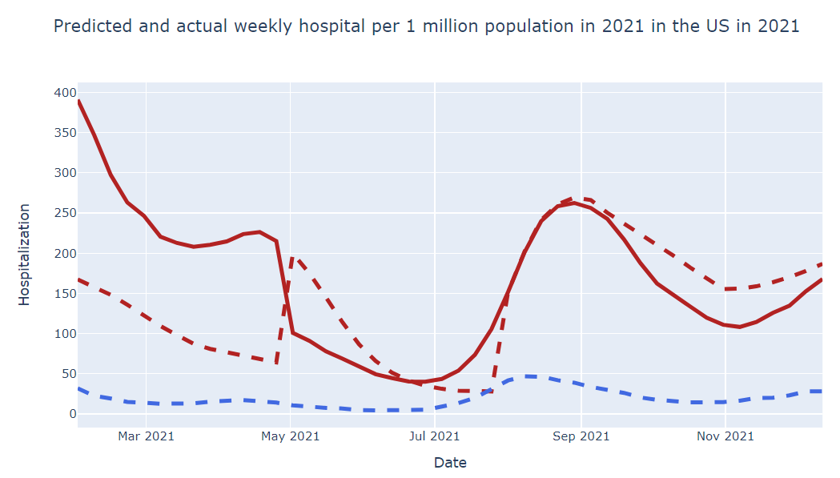
Predicted vs actual Hospitalization

Slide 16
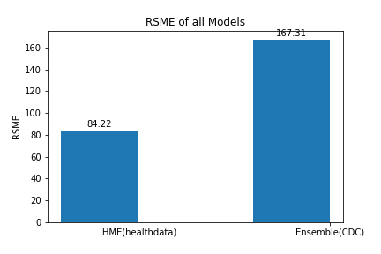
Result
Hospitalization RMSE

Slide 17
Conclusions and challenges
Data been separated in many sections. Data difficult to interpret due to lack discrtiption.
Limitation of Covid-19 predicted model
Unable to find any other model for other countries like Germany, Brazil, Peru, etc, beside IHME

Slide 18
References
Joseph Friedman, Patrick Liu, Christopher E. Troeger, Austin Carter, Robert C. Reiner Jr ,Ryan M. Barber, James Collins, Stephen S. Lim, David M. Pigott , Theo Vos, Simon I. Hay ,Christopher J. L. Murray5 & Emmanuela Gakidou, “Predictive performance of international COVID-19mortality forecasting models”. https://doi.org/10.1038/s41467-021-22457-w 2022.
Omer Noy, Dan Coster, Maya Metzger , ItaiAtar , Shani Shenhar‑Tsarfaty, Shlomo Berliner, Galia Rahav, Ori Rogowski & Ron Shamir, “A machine learning model for predicting deterioration of COVID‑19 inpatients.” https://www.nature.com/ 2022.

